Slide 1
optimal narrative perspective
RAY LC

Slide 2
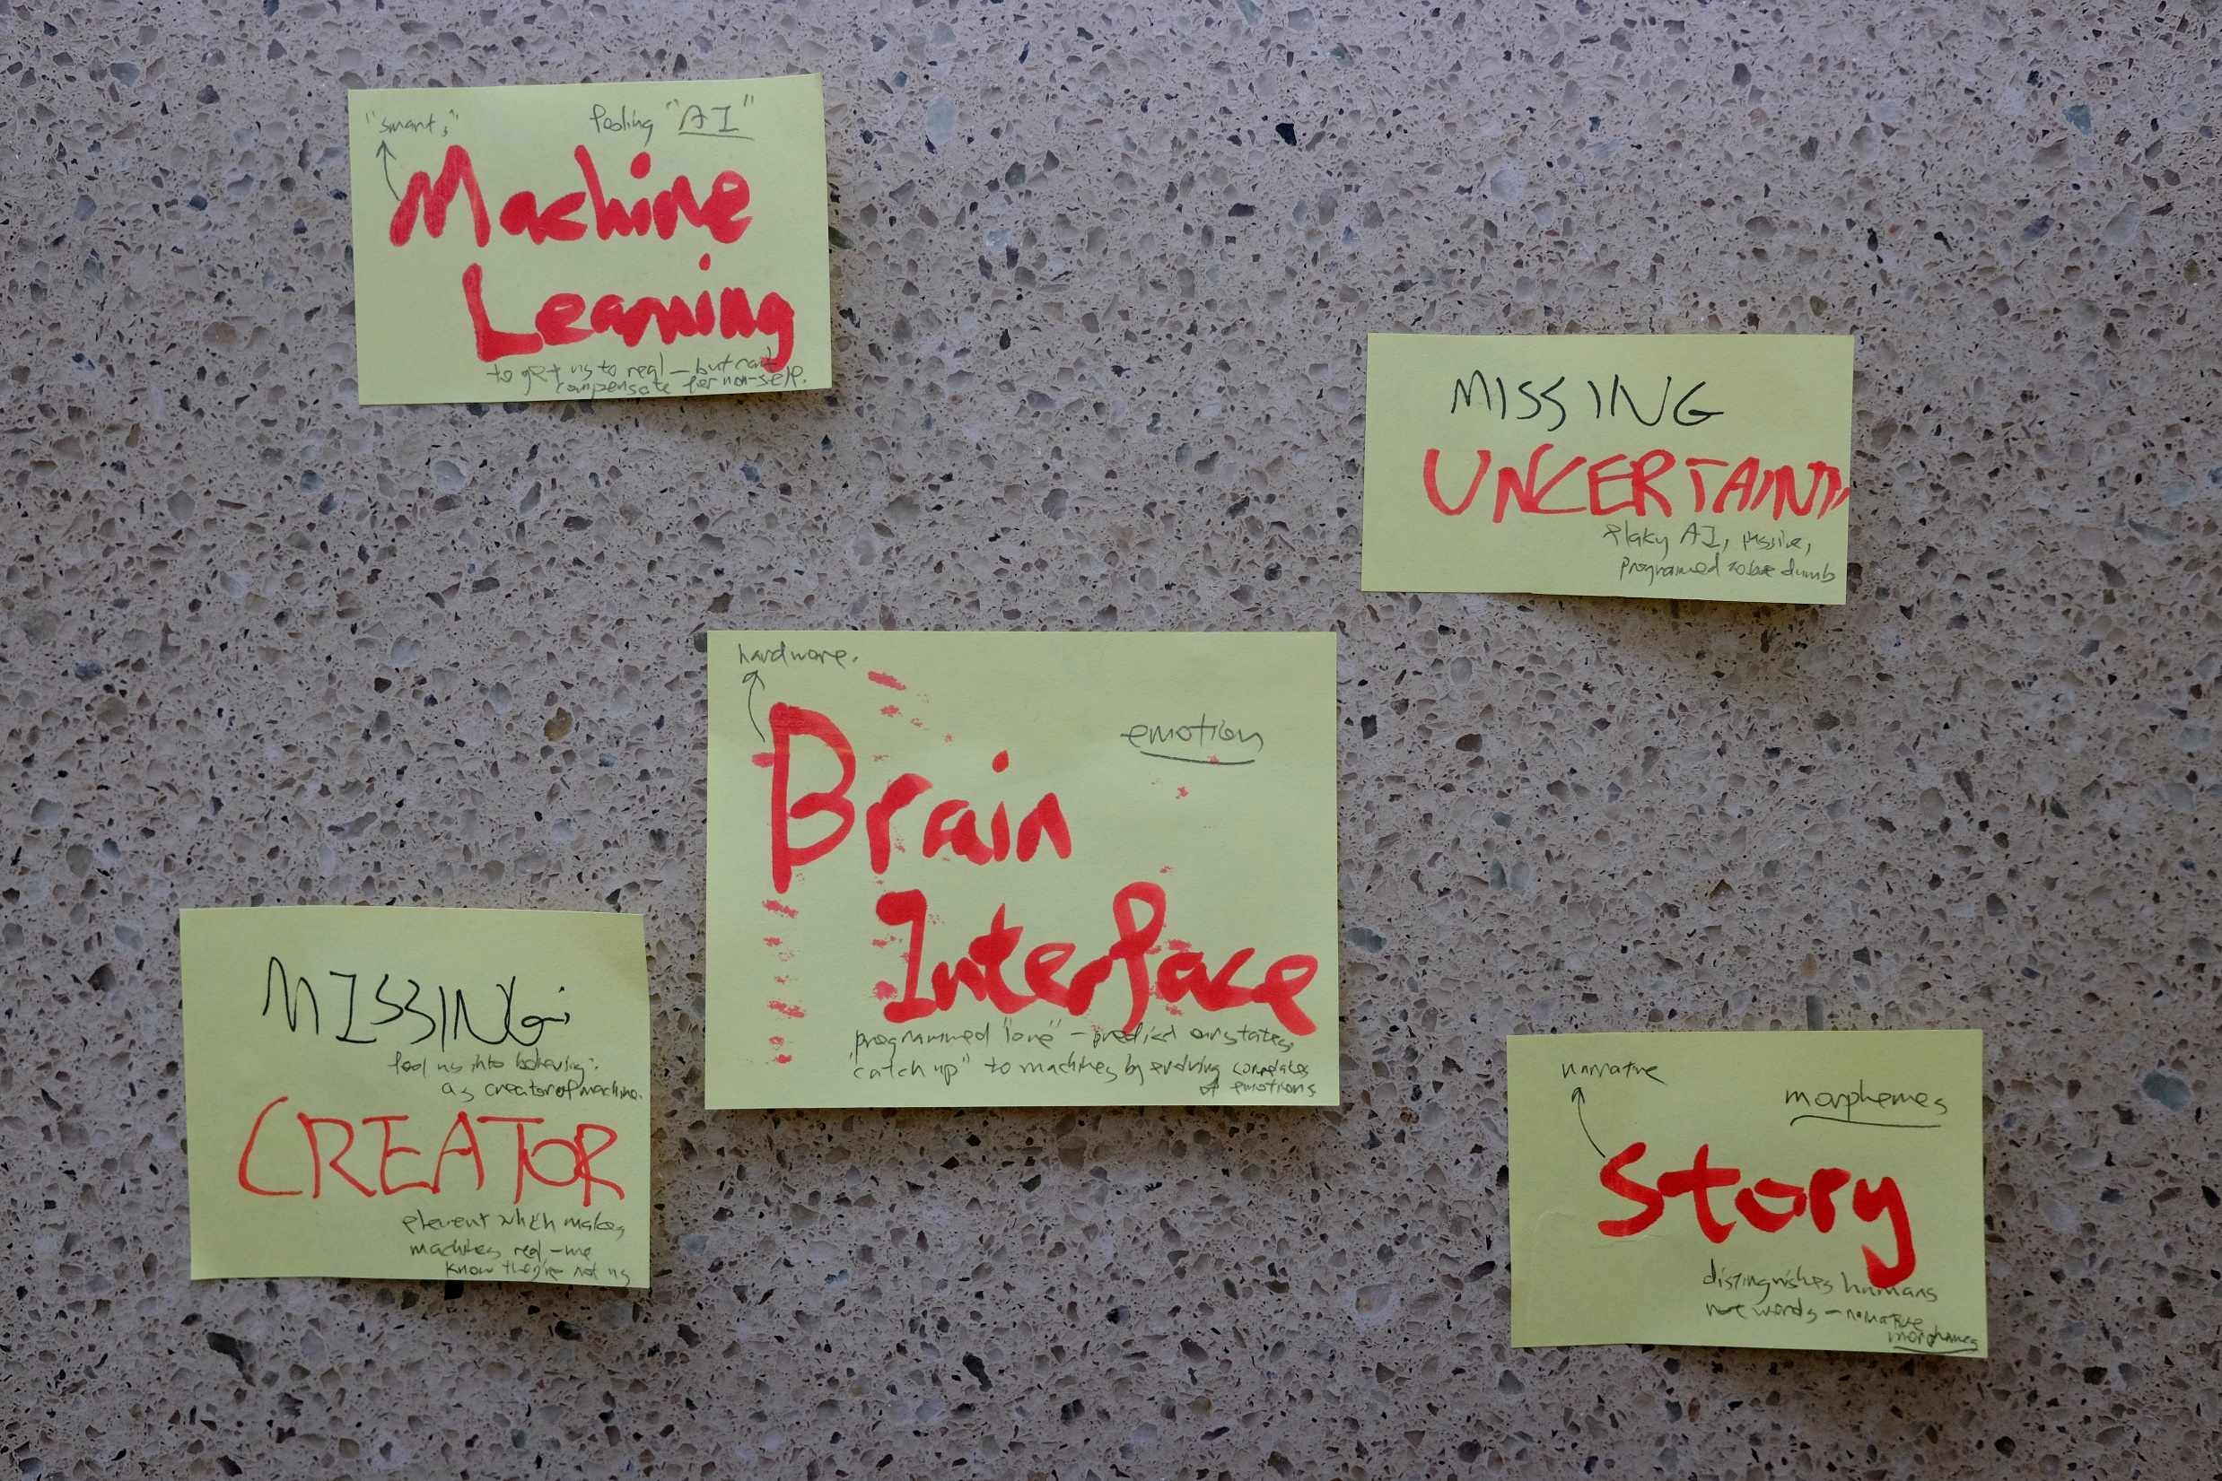

Slide 3
narrative: caring for the phone
◦
1D
2D
3D
4D
5D
◦
The lost cell phone, from phone’s perspective.
I wake her up everyday, hide inside her purse.
Abandoned me at the rest room, dirty, scared.
Handled by strangers, locked up, cover exposed.
Unknown GPS code, software failure, return?
We are subjective, how to stay objective?
Machines to teach us how to take points of view.

Slide 4
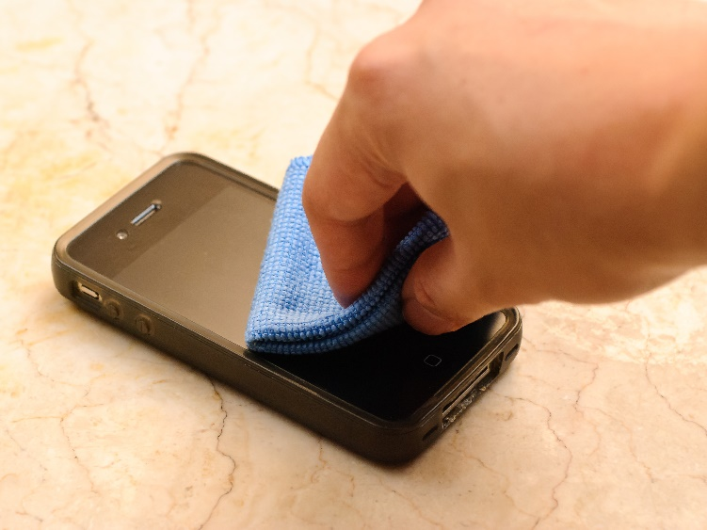
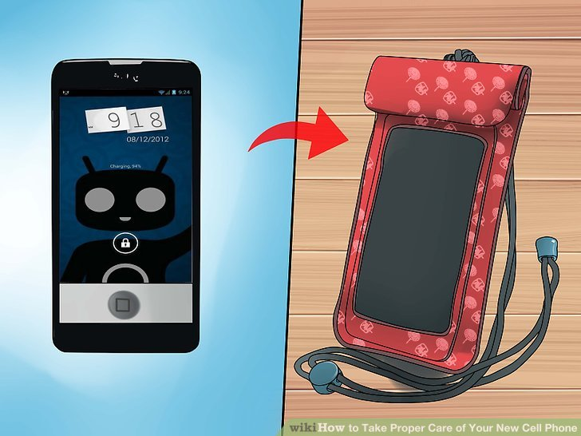

Slide 5
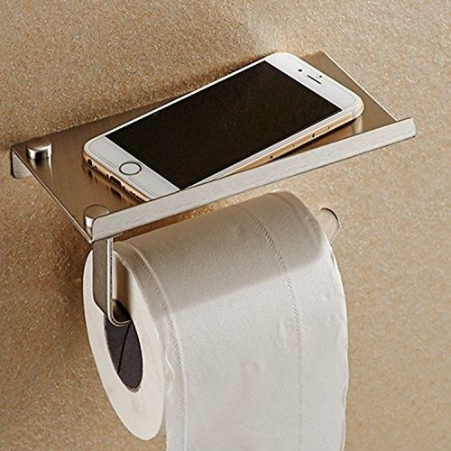
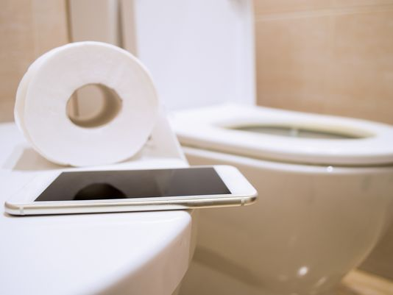


Slide 6
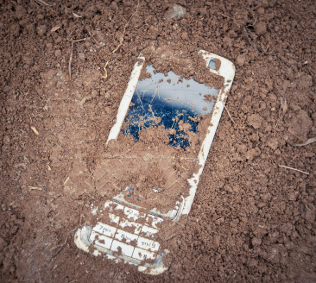
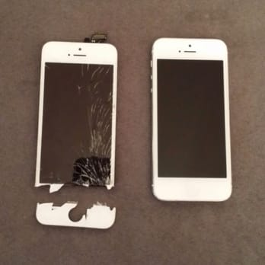

Slide 7
optimal: view yourself objectively
◦
1D
2D
3D
4D
5D
◦
Computer vision for feature integration.
Voice recognition for emotion.
See and hear yourself during interactions.
Show emotional states.
Interpretation of subjective views.
Machines that help us see ourselves clearly.

Slide 8
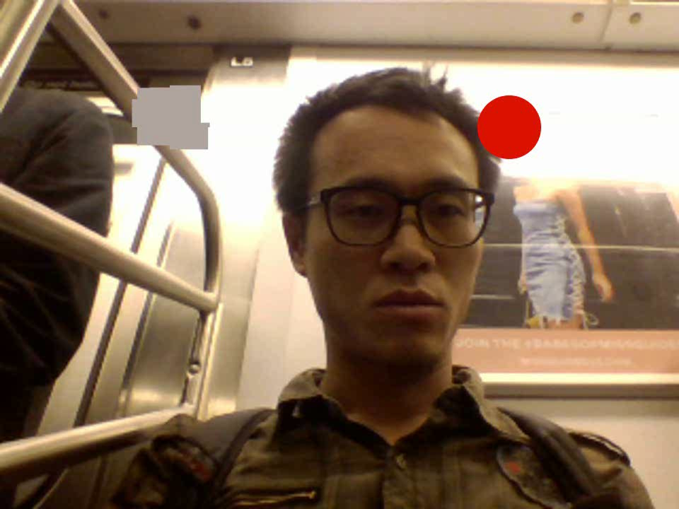

Slide 9
perspective: app that switches view
◦
1D
2D
3D
4D
5D
◦
See the views of others connected in social net.
See how the machine sees.
Authorized views only for privacy preserved.
Chat that sees perspective, not just told it.
For the disconnected in social world.

Slide 10
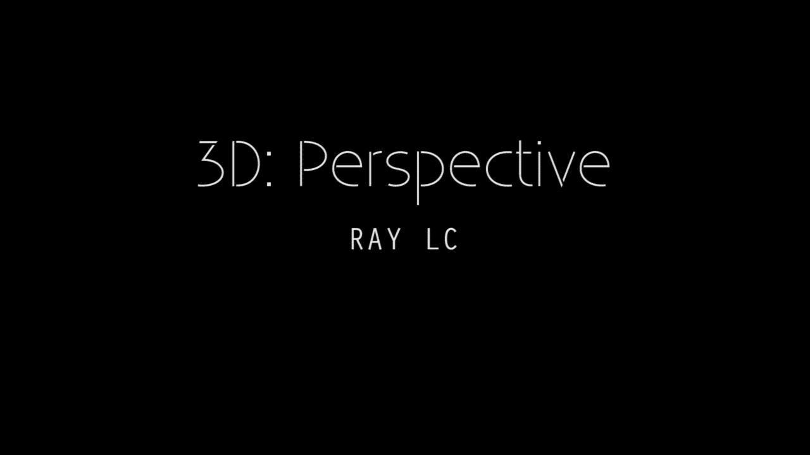

Slide 11
feedback
Pick one thing and implement it.
Too abstract.

